Slide 1
Olivia’s parts
UC-7. Send store code: The system receives the order information, and sends the QR code back.
UC-8. Scan store code: The cabinet scans the QR code.
UC-9. Open cabinet: The cabinet recognizes the QR code successfully and opens the cabinet.
Notes:
I'll introduce use cases 7 to 9. These are work for users to open the cabinet . I designed three steps for open the cabinet.

Slide 2
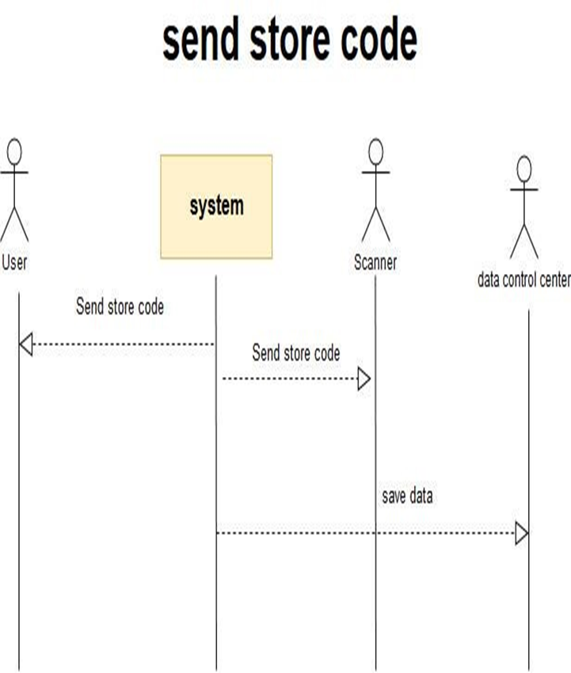
Use Case UC-（7）Send store code
Use Case UC-（7）Send store code
Related Requirement’s: REQ5, REQ8, table1-2 Initiating Actor: All of: senders Actor’s Goal: let the sender to take the food or takeout into the cabinet. Participating Actors: data processing center, information system Preconditions: The receivers have finished the order information. Post conditions: The system get the behavior and send the storage code, and let the senders take the food of takeout into the cabinet. Flow of Events for Main Success Scenario: ---àa. The receivers wrote the order information, ß---b. the system understood the meaning and send storage code to the senders ---àc. the senders will use the storage code to open the cabinet’s door. ß---d. The door opened.
Notes:
After users write the order information on phone or computer, the system will get the order information and sends the store code back. At the same time ,the system will send the behavior to data control center. The center label the behavior.
The system receives the order information, and sends the QR code back. REQ5 is user need way to store packages, so they need to open the cabinet to store packages.

Slide 3
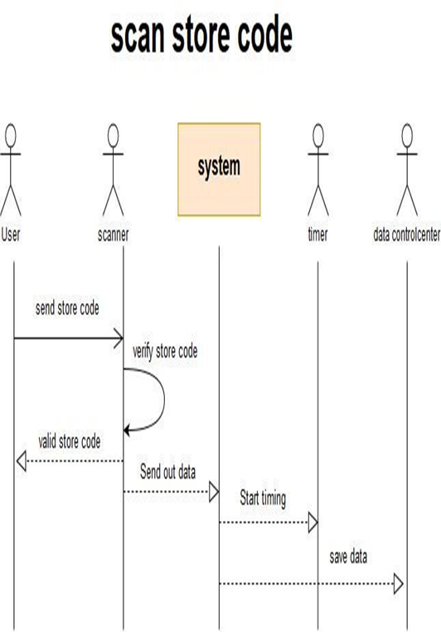
Use Case UC-（8）scan the store code
Use Case UC-（8）scan the store code
Related Requirement’s: REQ5, REQ8, table1-2 Initiating Actor: All of: senders Actor’s Goal: the senders want to take the food or takeout into the cabinet. Participating Actors: data processing center, information system Preconditions: The senders get the storage code Post conditions: The cabinet’s door is opened. Flow of Events for Main Success Scenario: --a. The senders get the code; he goes to the cabinet and scans the storage code. --b. The system confirms the behavior, and opens the door.
Notes:
In this use case, user goes to the cabinet and scan the store code on the cabinet.
After Scanner get the code , it will send the store code to system and verify the store code
After System get the behavior, it will send the behavior to data processing center , the center will label the behavior
The cabinet scans the QR code. REQ5 is user need way to store packages, so they need to open the cabinet to store packages.

Slide 4
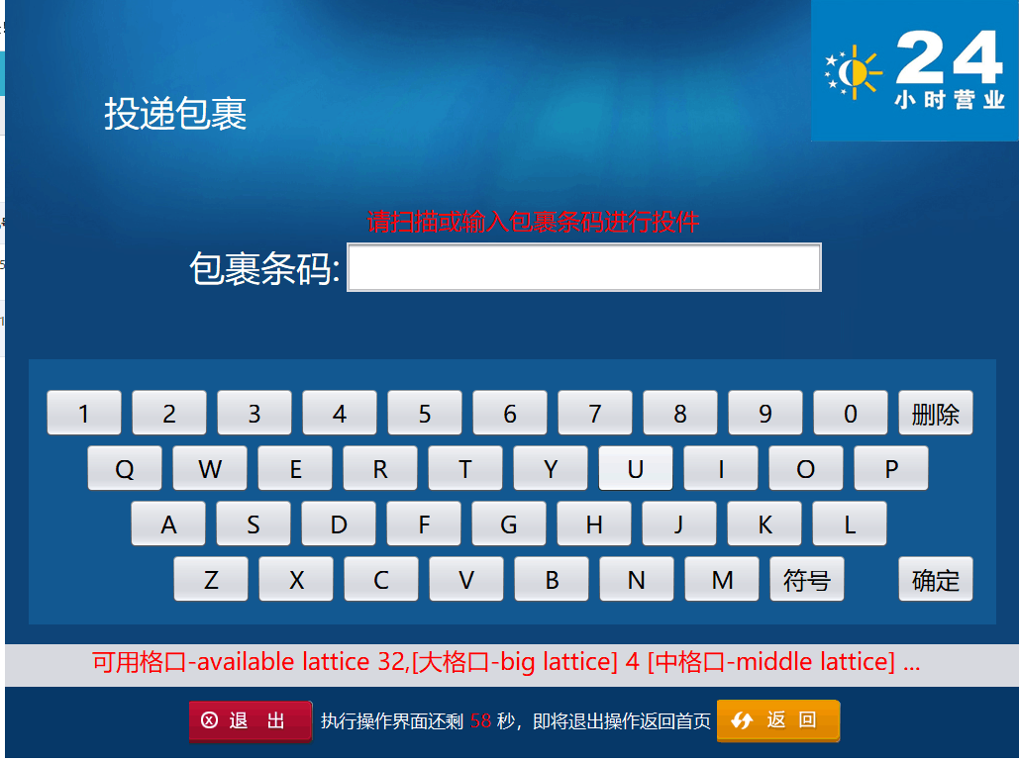
void VoiceTip() {
CCommondFunc.VoiceTip("请扫描或输入包裹条码进行投件-Please scan or enter the package bar code for submission.");
}
void SetTextBox() {
txtOrderID.SetTextBox(1, 20);
txtOrderID.setFocusable(true);
}
public void TTkeyBoardInput(CBaseEnum.KeyType eKeyType, String strInput) {
if (m_blNextClick) return;
FuncClass.CBaseTime.ReSetTime();// 重新计时
switch (eKeyType) {
case Key_BarCode:
txtOrderID.SetDefaultValue(strInput);
if (txtOrderID_Validated()) {
NextStep();// 验证通过自动调用下一步
}
break;
case Key_NUMBER:
if (!"".equals(strInput)) {
txtOrderID.InputText(strInput);
if (txtOrderID.GetText().trim().length() == 20 && txtOrderID_Validated()) {
NextStep();// 验证通过自动调用下一步
}
}
break;
Notes:
some code of Scan parts
You must enter box id , and password
Verify the box id and password
If you enter the correct verification code, the system will automatically proceed to the next step

Slide 5
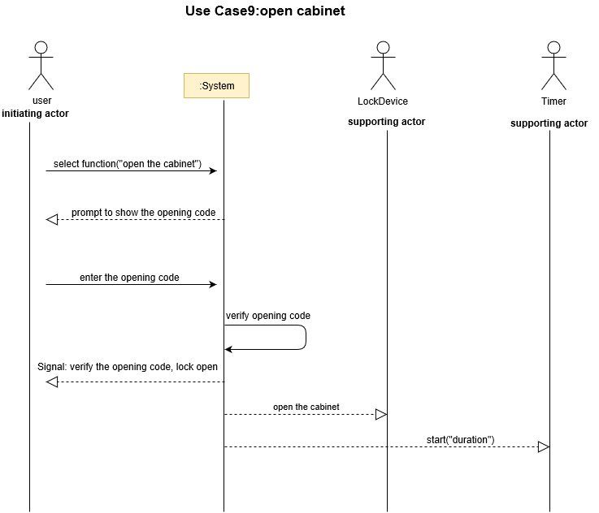
Use Case UC-（9）Open cabinet
Use Case UC-（9）Open cabinet
Related Requirement’s：REQ5, REQ8, table1-2 Initiating Actor: Any of: recipients Actor’s Goal: Get the own food and takeout Participating Actors: cabinet, door of the, scanner, system, data Processing Center Preconditions: Recipients got the fetch code and scan the QR code. Post conditions: The door opened. Flow of Events for Main Success Scenario: --àa. The recipients got the message and use the fetch code to scan the QR code. ß---b. The system will confirm the behavior. The recipients open the door.
Notes:
The cabinet system verify the store code successfully
It will told lock device , open the lock . Then the cabinet door will open .
People can put some they want in the cabinet.
REQ5 is user need way to store packages, so they need to open the cabinet to store packages.

